Slide 1
TECHFEST 2026 | INNOVATION HACKATHON
HunarShakti
AI-Driven Skill Mapping & Micro-Gig Platform for Rural Women
PROJECT FOCUS
INSTITUTION
PROTOTYPE
Voice-First AI & Biometric Micro-Payments
SLIET / Participating Institute
Working Engineering Model

Slide 2



01. PROBLEM UNDERSTANDING
The Rural Female Workforce Paradox
Invisible Skill Reserve
Unprofiled artisan and craft skills remaining outside digital market aggregators.
73%
Digital Literacy & Language Friction
Unorganized Rural Skilled Labor
Conventional text platforms fail non-literate workers in regional dialects.
Off-grid workforce lacking direct market integration tools.
Middleman Margin Exploitation
Informal supply channels extract up to 70% of artisan labor value.

Slide 3



02. PROPOSED SOLUTION
HunarShakti Platform Architecture
BHASHINI Voice Onboarding
pgvector Skill Matcher
AEPS / UPI Biometric Escrow
Conversational dialect pipeline maps user skills without requiring text literacy.
High-dimensional vector embeddings connect artisan capabilities directly to buyer orders.
Direct escrow payouts trigger instantly to Aadhaar-linked accounts upon quality audit.

Slide 4
03. OPERATIONAL MECHANISM
End-to-End Data Pipeline Flow
STAGE 01
STAGE 02
STAGE 03
Natural Input (Edge)
Compute & Validation
Settlement (Fintech)
Dialect voice capturing and edge compression pipeline.
Automated quality inspection and vector indexing.
Automated escrow release and direct payment.
Product Photo
YOLOv8 Feature Extraction
Dialect Voice Audio
Stitch/Weave Density Grading
Work Validation
Low-bitrate Opus Compression
Vector Match Engine
Escrow Hold Trigger
BHASHINI ASR/NMT Pipeline
pgvector Cosine Matcher
AEPS/UPI Cash Disbursement

Slide 5
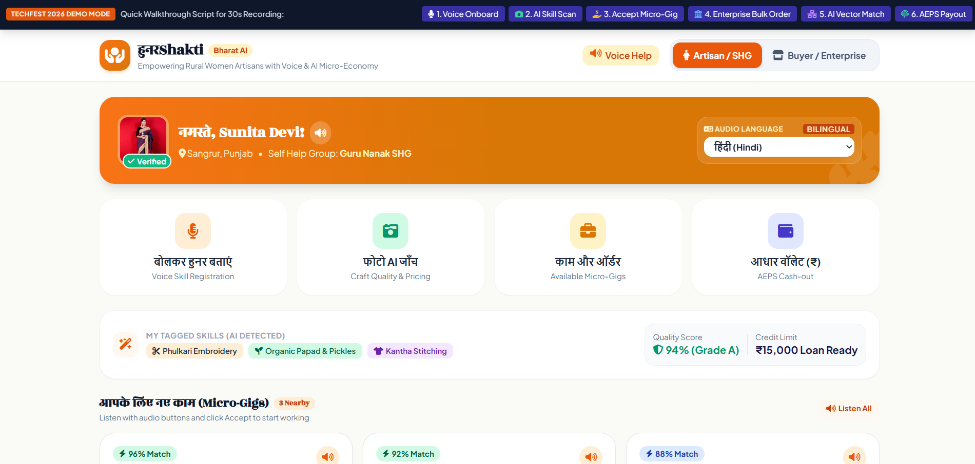
04. TECHNICAL DEPTH
System Architecture & Tech Stack
FRONTEND LAYER
SPEECH PIPELINE
PWA Service-Worker Local SQLite Sync
BHASHINI Speech-to-Speech Dialect Pipeline
React Native framework with zero-text iconography interface.
FastAPI REST microservices with Govt. Bhashini dialect stack.
VECTOR DATABASE
PAYMENT GATEWAY
pgvector Cosine Similarity Matcher
AEPS / UPI Biometric Escrow Middleware
PostgreSQL instance running pgvector for skill proximity search.
Aadhaar biometric authentication and milestone escrow releases.

Slide 6
05. AI/ML WORKING MECHANISM
Deep Tech Execution Stack
VOICE AI PIPELINE
VISION MODEL
MATCHING ENGINE
BHASHINI Speech-to-Speech Dialect Pipeline
YOLOv8 Edge Computer Vision Scoring
pgvector Cosine Similarity Matcher
Converts dialect voice payloads into structured JSON attributes for speed, domain, and experience profiling.
Evaluates craft photo uploads for stitch symmetry, weave density, and visual quality tiers.
Calculates mathematical distance between buyer requirements and registered skill vector profiles.

Slide 7



06. SYSTEM FAULT-TOLERANCE
Engineered Resiliency for Rural Realities
Low Connectivity Challenge
Mitigation: Offline-First PWA architecture caches audio payloads locally in SQLite and executes background batch syncs upon signal recovery.
Low Bandwidth Challenge
Mitigation: Voice payloads are compressed down to 16 kbps using WebM/Opus codecs before hitting API endpoints.
Literacy Barrier
Mitigation: Zero-text UI relying entirely on iconographic navigation and speech-driven interactive prompts.

Slide 8
07. FINANCIAL ANALYSIS
Cost Structure & Revenue Model
Estimated Setup Cost
Revenue Streams
Cloud & BHASHINI API Infra
₹45,000 / mo
B2B Order Facilitation Fee
3% Commission
Community SHG Facilitator Kits
₹60,000 (One-time)
Corporate CSR & NRLM Grants
Govt Subsidies
YOLOv8 & Voice Model Hosting
₹30,000 / mo
Premium Artisan Showcase
Subscription Tier

Slide 9
08. SCALABILITY & ROADMAP
Technology Readiness Level (TRL) Roadmap
CURRENT
NEXT 3 MONTHS
6–12 MONTHS
Phase 1 (TRL 4)
Phase 2 (TRL 6)
Phase 3 (TRL 9)
Functional Prototype
Field Pilot
Scaled Deployment
Field pilot with 50 rural SHG artisans; fine-tuning YOLOv8 model weights on regional handicraft datasets.
Scaled deployment with state rural livelihood missions; integration with micro-credit scoring APIs based on craft output history.
Functional prototype validated with multi-modal AI voice and vision grading pipeline.

Slide 10
TECHFEST 2026 @ SLIET
Thank You!
HunarShakti: Bridging the digital divide to create sustainable livelihoods for rural women.
Open for Q&A & Jury Evaluation

